Slide 1


Data to information
Graphical representations

Slide 2
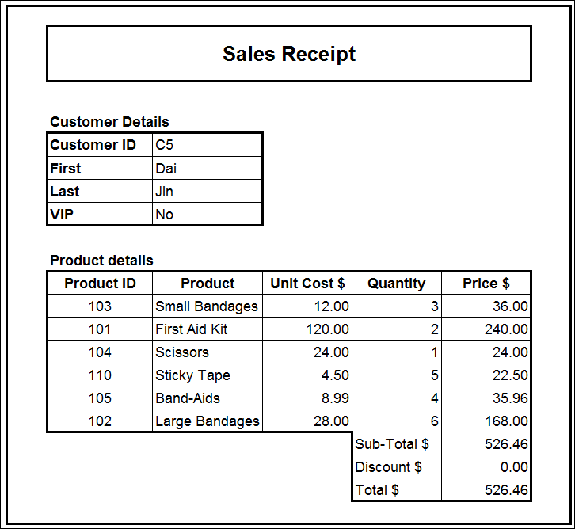
Revision: terminology
Think, pair, share
Discuss the meaning of the following terms with the students around you, then report back to the group.
COUNTIF
SUMIF
LOOKUP
Spreadsheet assignment 3
Discuss any issues/problems encountered during spreadsheet assignment 3.

Slide 3
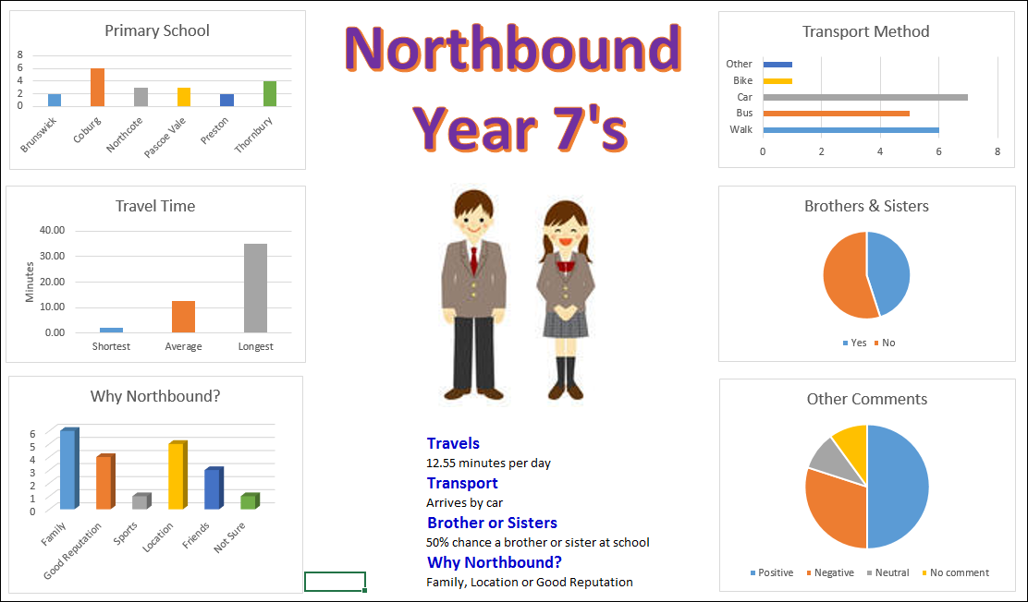
Pre-class activity
10 multiple choice questions
Types of graphs
Pie chart
Line graph
Column chart
Histogram
Bar graph
Infographics

Slide 4
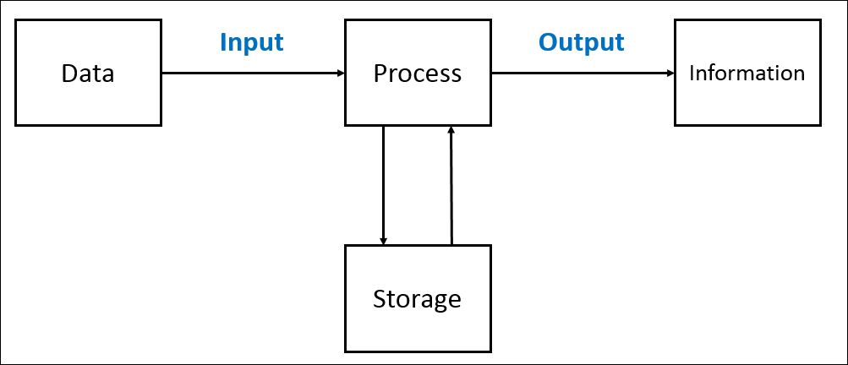
Graphical representations
Remember the definitions of:
Data
Information
An information system is used to produce data into information.
Information can be produced in many formats.
A common format used to present information is using graphical representations.

Slide 5
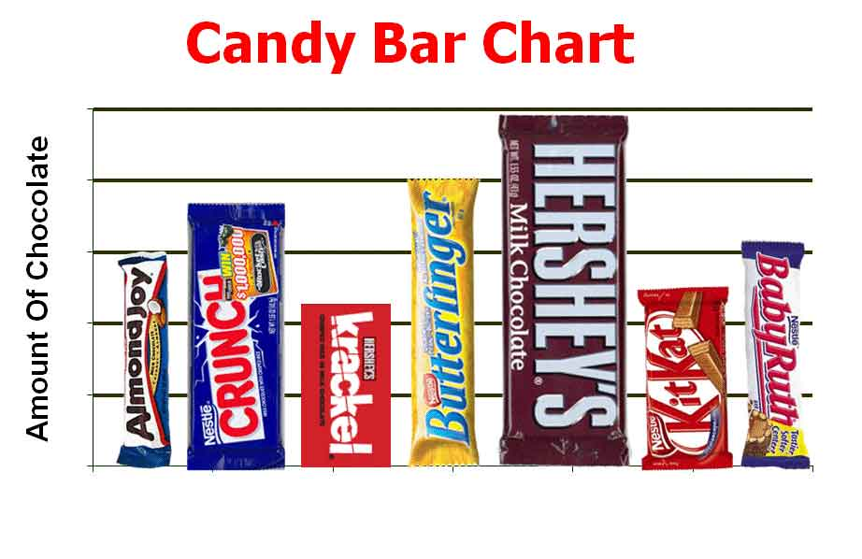
Graphical representations
A simple definition of graphical representation is to present data in a graphical or picture format.
Three advantages of presenting data in a graphical or picture format are:
It is easier for a user to understanding the data when presented graphically.
It is faster for the user to interpret the data when shown in a graphical format.
Users engage more with graphical formats as they are more attractive and eye-catching.

Slide 6
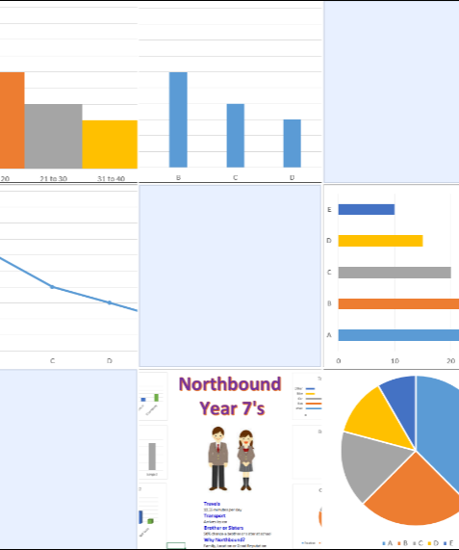
Graphical representations
Types of graphs
There are hundreds of types of graphical representations.
In this Unit, we will study six types of graphical representations:
Bar graph
Column graph
Infographic
Line graph
Histogram
Pie chart

Slide 7
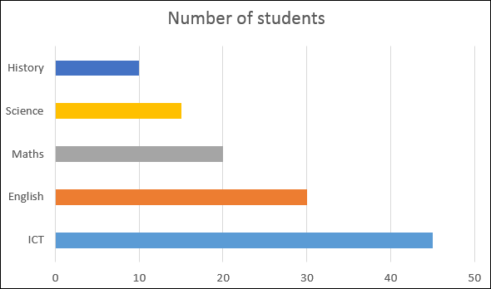
Graphical representations
Bar graph
Bar charts display the data using bars that appear horizontally across the graph.
Bar graphs are used to compare different data items.
The data type appears on the Y axis.
The value or number appears on the X axis.

Slide 8
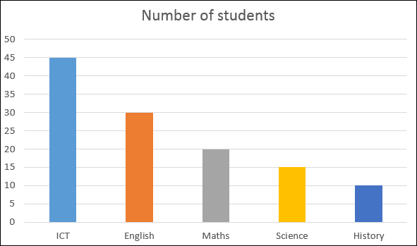
Graphical representations
Column graph
A column graph is very similar to a bar graph.
Column graphs display data using bars that appear vertically up the graph.
Column graphs are used to compare different data items.
The data type appears on the X axis.
The value or number appears on the Y axis.

Slide 9
Graphical representations
Infographic
An infographic is more than just a picture
An infographic combines graphs, images and text.
They provide more information than just a graph alone.
They are used to communicate a story or message to other people.
They are often used in advertising.
Google “infographics” to see many examples.

Slide 10
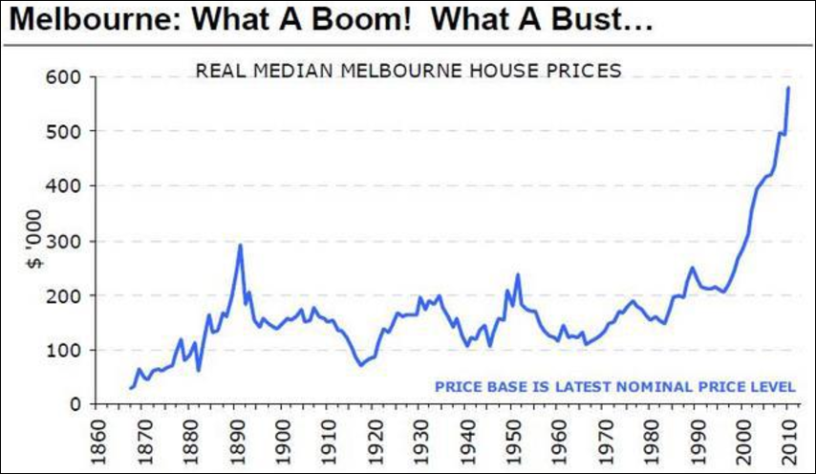
Graphical representations
Line graph
Line graphs are used to show the performance of one data item over a period of time.
The time measurement appears on the X axis.
The data item measurement appears on the Y axis.
The example shown shows the cost of houses in Melbourne over the last 100 years.
Cost of houses is the data item.
Years is the time measurement.

Slide 11
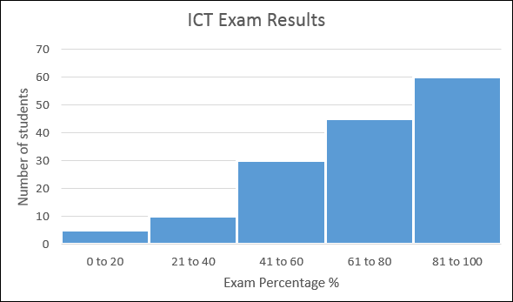
Graphical representations
Histogram
At first glance a histogram looks the same as a column graph.
Column graphs are used to compare different items.
Histograms are used to classify data items into groups, then count how many items are in each group.
They are useful for converting qualitative data into quantitative data.

Slide 12
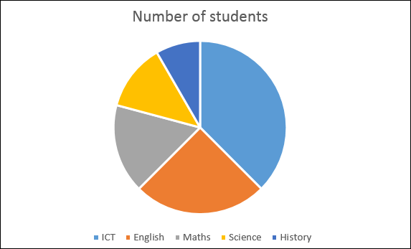
Graphical representations
Pie chart
Pie charts present data in one round circle.
Each wedge of the pie represents one data item.
It is used to see how the proportion of that each data item represents to the whole.
In the example ICT students are the largest group of students at the College.

Slide 13
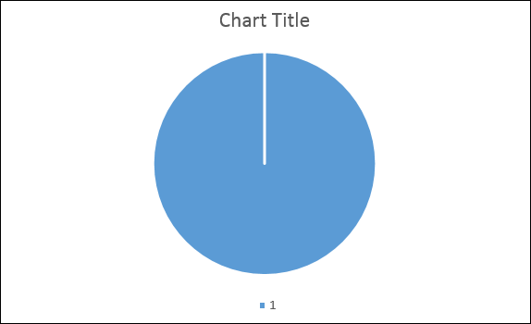
Graphical representations
Correct graph type
Not all graph types are suitable for each set of data.
It is important to check if the message that you want to communicate is visible in the graph you have selected.
What is the problem with the graph shown?

Slide 14
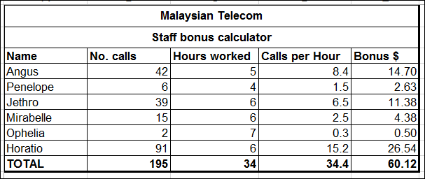
Graphical representations
Conventions used in graphs
We studied conventions earlier when using spreadsheet software.
Discuss the conventions used in a spreadsheet.

Slide 15
Graphical representations
Conventions used in graphs
We studied conventions earlier when using spreadsheet software.
Discuss the conventions used in a spreadsheet.
Text left aligned
Numbers right aligned
Numbers have 0 or 2 decimal places
Headings and sub-headings in bold
Measurements included in the column header

Slide 16
Graphical representations
Conventions used in graphs
Conventions are followed to help make the information presented as easy to read and understand as possible.

Slide 17
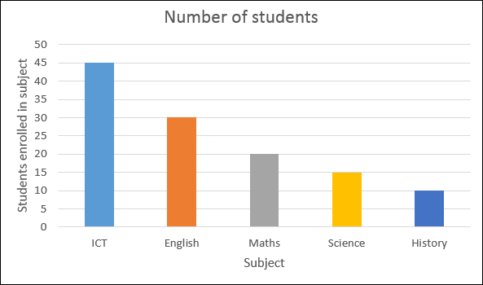
Graphical representations
Conventions used in graphs
For graphs that contain X and Y axis, three common conventions used are:
Graph title
X-axis title
Y-Axis title

Slide 18
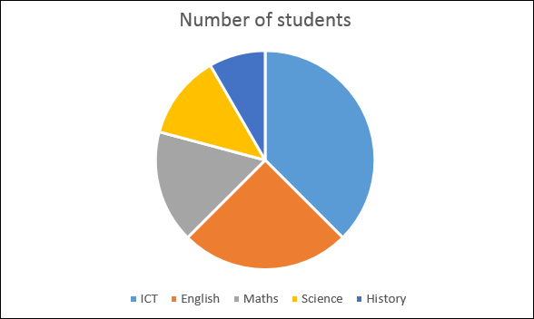
Graphical representations
Conventions used in graphs
For graphs that do not contain an X and Y axis (a pie chart):
Graph title
Each wedge is a different colour
Legend

Slide 19
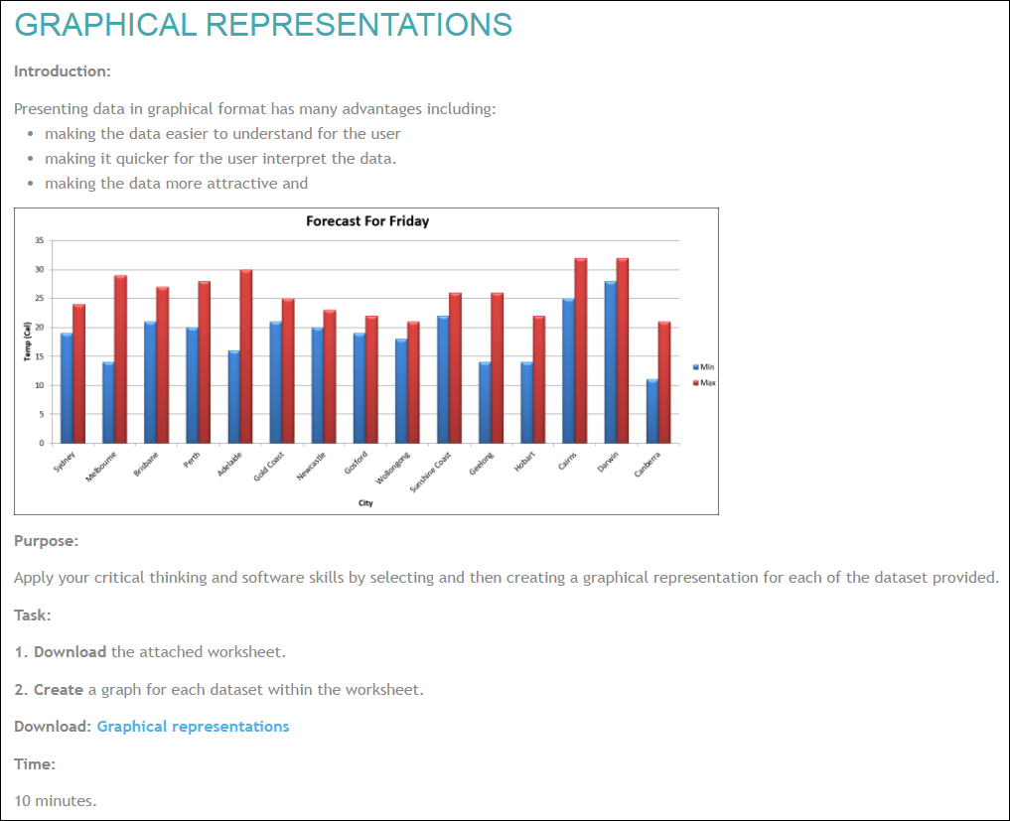
Activity: Graphical representations
Go to elearn and download the graphical representation activity.

Slide 20
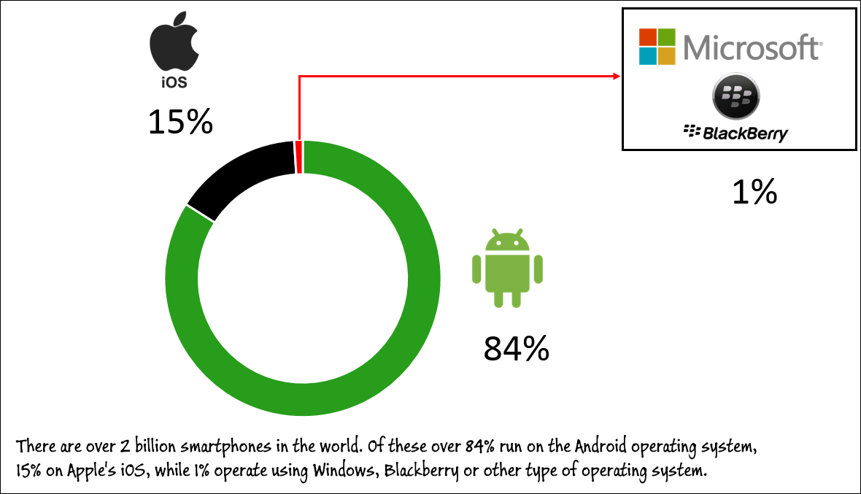
Activity: Infographics
Infographics combines text, images and graphs to present information.
Activity
Go to elearn and download the infographics activity.
The finished infographic should look similar to the example shown.

Slide 21
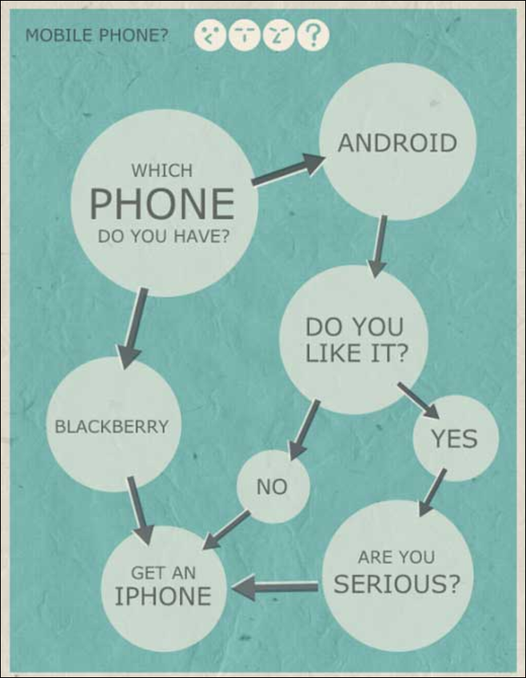
Infographics
Online infographic tools
There are many online tools that will assist you to create infographics and graphs.
You may like to use these tools in your studies for the unit.
These include:
Infogram
Piktochart
Venngage
Canva
Easel.ly

Slide 22
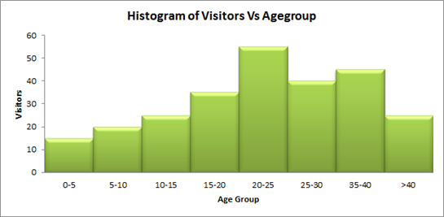
Histograms
Histograms are graphs that sort data into groups.
The count or frequency of each group is calculated and represented in a graph.
The total of each group can be calculated manually or be using a COUNT function.
There is also a spreadsheet add-on that helps to create histograms.

Slide 23
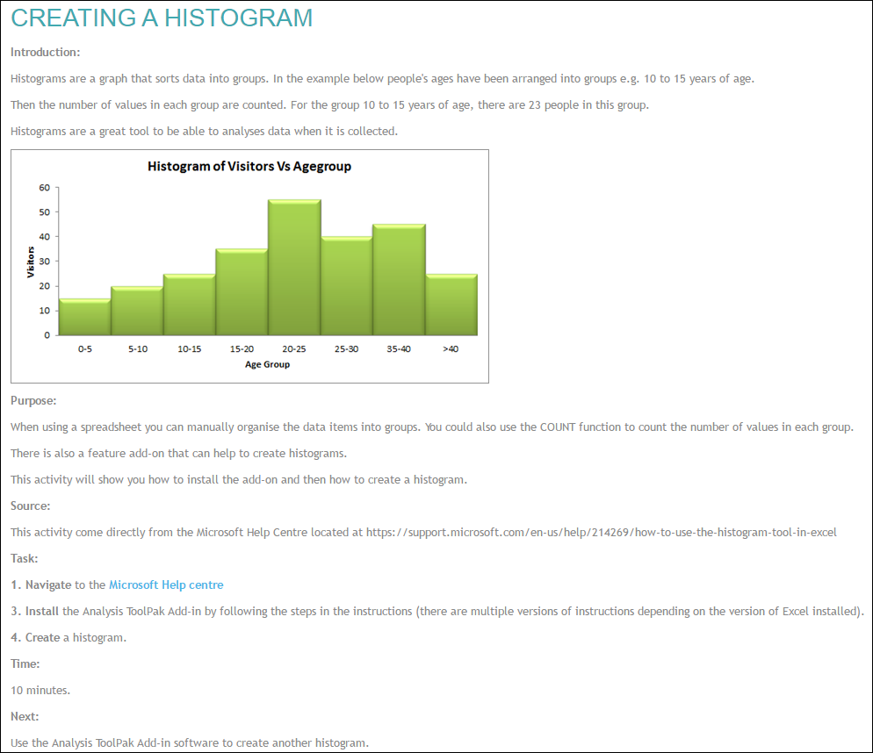
Activity: Histograms
Go to elearn and follow the hyperlink to the instructions to install the histogram add-in and create a basic histogram.

Slide 24
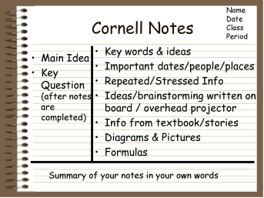
Notes/Glossary
Create notes on the following areas from todays class:
Graphical representations
Advantages of graphical representations
Graph conventions
Types of Graphs
Bar
Column
Line
Infographic
Histogram
Pie

Slide 25
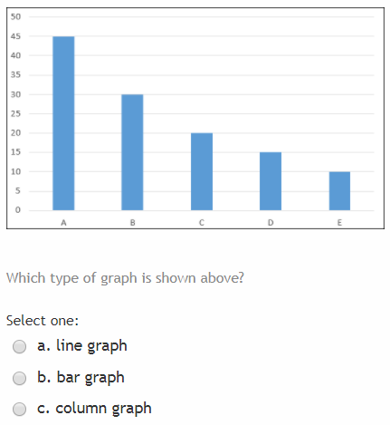
Post-class activity
Complete the same quiz that you completed before class to measure how much you have learnt this lesson.

